Slide 1
A Formal Tasking Grammar:
The Command and Control Lexical Grammar
Presented to the MSDL PDG – April 17, 2008
Dr. Michael Hieb
Dr. Ulrich Schade
George Mason University
FGAN-FKIE
US
GERMANY
mhieb@gmu.edu
schade@fgan.de

Slide 2
Content
  Describing Tasks
  Building a Formal Language
  The Tasking Grammar
  Experience to date

Slide 3
Content
  Describing Tasks
  Building a Formal Language
  The Tasking Grammar
  Experience to date

Slide 4
Overview
The purpose of this work is to develop a formal language that will describe tasks to a level of detail sufficient for input to automated systems.
In particular, this work has been developed for Command and Control applications in military domains, but also aims to be general enough to apply to a broad class of operations that occur through space and time.

Slide 5
Content
  Describing Tasks
  Building a Formal Language
  The Tasking Grammar
  Experience to date

Slide 6
The Development of a Formal Grammar
Formally, a grammar G consists of
a lexicon Σ (which is a set of terminal symbols, the words),
N, a set of non-terminal symbols,
P, a set of production rules, and
S, the start symbol.
G = {Σ, N, P, S}
In addition, the following holds: S ∈ N and N ∩ Σ = ∅.

Slide 7
Developing a Formal Tasking Grammar
Design principles:
The lexicon is based on the JC3IEDM and consistent with MSDL.
Constituency is inspired by the 5Ws.
  - Defining roles for each term in the grammar.
The grammar is lexically-driven.
  - The “verb” determines which types of constituents are needed and determines the semantic roles of the constituents.

Slide 8
Developing a Formal Tasking Grammar
What
(Who)
Who
Who
What
Where
When
Why
The 5 Ws in a hierarchy
The next step:
Tasking expressions have to be understandable by systems,
Therefore, one has to assign semantic (thematic) roles to the 5 Ws.

Slide 9
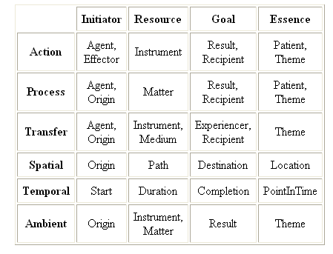
Developing a Formal Tasking Grammar
Thematic Role as suggested by
Sowa (2000): Knowledge Representation
Notes:
<http://www.jfsowa.com/ontology/thematic.htm>
examples:
Patient < Essence; Ptnt(Process,Physical).
An essential participant that undergoes some structural change as a result of the event.
Theme < Essence; Thme(Situation,Entity).
An essential participant that may be moved, said, or experienced, but is not structurally changed.

Slide 10
Developing a Formal Tasking Grammar
Which thematic role is represented by which W?
What
Why
Result
Who
Agent
What
Patient
Theme
When
Start
Completion
(Who)
Who
Where
Origin
Path
Destination
Location
Next step: Use linguistic principles to insert un-ambiguity.

Slide 11
Developing a Formal Tasking Grammar
Task
Why
Result
Tasker
Taskee
Agent
Affected
Patient
Theme
Start-When
Start
End-When
Completion
Who
Route-Where
At-Where
Source
Origin
Destination
Destination
Path
Path
Location
Location

Slide 12
Developing a Formal Tasking Grammar
The realization of a “tasking grammar” (Command and Control Lexical Grammar - C2LG) as a kind of LFG (“Lexical Functional Grammar”)
ensures that semantic roles can be assigned one-to-one
to their corresponding parts (constituents) of BML expressions.
C2LG expression → c-structure → f-structure
The assigned semantic roles
then specify the [unambiguous] interpretation of Task.
Bresnan, J. (2001). Lexical-Functional Syntax. Malden, MA: Blackwell.

Slide 13
An Extensive Literature on LFG
http://www.essex.ac.uk/linguistics/LFG/
Bresnan, Joan. 1972.
Theory of complementation in English syntax.
Ph.D. thesis, MIT.
Bresnan, Joan (editor). 1982b.
The Mental Representation of Grammatical Relations.
Cambridge, MA: The MIT Press.
Kaplan, Ronald M. and Annie Zeanen. 2003.
Things are not always equal.
In A. Gelbukh (editor), Computational Linguistics and
Intelligent Text Processing, pp. 205--216. Heidelberg, Springer Verlag.
Lecture Notes in Computer Science, Volume 2588.
Dalrymple, Mary. 2001.
Lexical Functional Grammar, volume 34 of Syntax and
Semantics.
New York: Academic Press.
A Sample
1148 Entries in
LFG Bibliography!

Slide 14
Content
  Describing Tasks
  Building a Formal Language
  The Tasking Grammar
  Experience to date

Slide 15
A Tasking Grammar
The production rules for the basic expressions
have the following general form:
B → Verb Tasker Taskee (Affected | Action)
Where Start-When (End-When) Why Label (Mod)*
“Verb” is an action, normally a task;
“Tasker” is a “Who”, the unit which commands the task;
“Taskee” is a “Who”, the unit which executes the task;
“Affected” is the object which affected by the task;
“Action” is another task affected by the task;

Slide 16
A Tasking Grammar
The production rules for basic expressions
have the following general form:
B → Verb Tasker Taskee (Affected | Action)
Where Start-When (End-When) Why Label (Mod)*
“Where” is a “location phrase”;
the “When”s are “time phrases”;
“Label” is a label given to the task in order allow it to be referred in other basic expressions.
“Mod” are optional modifier terms.

Slide 17
A Tasking Grammar
The production rules for basic expressions
have the following general form:
B → Verb Tasker Taskee (Affected | Action)
Where Start-When (End-When) Why Label (Mod)*
Whether there is “Affected” or “Action” is determined by
the verb. This is indicated by the round brackets. The
Verb also determines the kind of Where (At-Where or
Route-Where) to be used.

Slide 18
A Tasking Grammar
The Why Term represents a reason for the task – the mission’s purpose.
The Why can be expanded as:
  Why → in-order-to PVerb (Affected | Action)
  Why → in-order-to cause (EndState)
  Why → in-order-to enable (Action)
Pverb is a type of verb that expresses a “Purpose”
Notes:
FM 3-90 [USA, 2001] offers a list of verbs to express the Why, namely divert, enable, deceive, deny, prevent, open, envelope, surprise, cause, protect, allow, create, influence, and support. We will label these verbs “purpose-verbs”. From a linguistic perspective, the verbs can be divided into three groups, namely
1) those that can be used with an argument that is an object,
like “in order to deceive the enemy”,
2) those that cause a state, and
3) those that need another task as argument, like “in order to enable task DELTA”.

Slide 19
A Tasking Grammar
Rules for basic expressions (sample selection)
(“verbs” are taken from C2IEDM-table “action-task-category-code”)
B → advance Tasker Taskee Route-Where Start-When (End-When) Why Label
B → ambush Tasker Taskee Affected At-Where Start-When (End-When) Why Label
B → assemble Tasker Taskee Affected At-Where Start-When (End-When) Why Label
B → assist Tasker Taskee Action At-Where Start-When (End-When) Why Label
B → attack Tasker Taskee Affected At-Where Start-When (End-When) Why Label
B → avoid Tasker Taskee Action At-Where Start-When (End-When) Why Label
B → block Tasker Taskee Affected At-Where Start-When (End-When) Why Label
B → breach Tasker Taskee Affected At-Where Start-When (End-When) Why Label
B → build-up Tasker Taskee Affected At-Where Start-When (End-When) Why Label
B → capture Tasker Taskee Affected At-Where Start-When (End-When) Why Label
B → clear(land) Tasker Taskee At-Where Start-When (End-When) Why Label
B → clear(obstacle) Tasker Taskee Affected At-Where Start-When (End-When) Why Label
B → concentrate Tasker Taskee At-Where Start-When (End-When) Why Label
B → confiscate Tasker Taskee Affected At-Where Start-When (End-When) Why Label
B → consolidate Tasker Taskee At-Where Start-When (End-When) Why Label

Slide 20
A Tasking Grammar
Rules for constituents (examples, continued)
Start When → at Time
At-Where → at Location
Route-Where → ( Source ) Destination ( Path )
Route-Where → along Route
Route-Where → towards Direction
Source → from Location
Destination → to Location
Path → via Location

Slide 21
Some Examples of C2LG Orders
B  advance Tasker Taskee Route-Where Start-When (End-When) Why Label (Mod)*
B  assist Tasker Taskee Action At-Where Start-When (End-When) Why Label (Mod)*
B  pursue Tasker Taskee Affected Route-Where Start-When (End-When) Why Label (Mod)*
An actual order:
pursue Battalion-C Company-B Enemy-Unit-105 along Road-Z at now in order to destroy Enemy-Unit-105 label_3_15;

Slide 22
Content
  Describing Tasks
  Building a Formal Language
  The Tasking Grammar
  Experience to date

Slide 23
C2LG Research Papers – Widely Recognized
April 2006 - On the Conference “Recommended Reading List”
Schade, U. & Hieb, M., “Formalizing Battle Management Language: A Grammar for Specifying Orders,” Spring Simulation Interoperability Workshop, Huntsville, AL.
June 2006 - Nominated for Best Paper at the ICCRTS
Schade, U. & Hieb, M., “Development of Formal Grammars to Support Coalition Command and Control: A Battle Management Language for Orders, Requests, and Reports”, Proceedings of the 11th International Command and Control Research and Technology Symposium, Cambridge, UK.
June 2007 - At the ICCRTS
Hieb, M.R. & Schade, U. “Formalizing Command Intent Through Development of a Command and Control Grammar”, Proceedings of the 12th International Command and Control Research and Technology Symposium, Newport, RI.
June 2008 - Nominated for Best Student Paper at the ICCRTS
Gustavsson, P., Hieb, M.R., Ericsson, P., More, P. & Niklasson, L. “Machine Interpretable Representation of Commander’s Intent”, Proceedings of the 13th International Command and Control Research and Technology Symposium, Bellevue, WA. (To Appear)

Slide 24
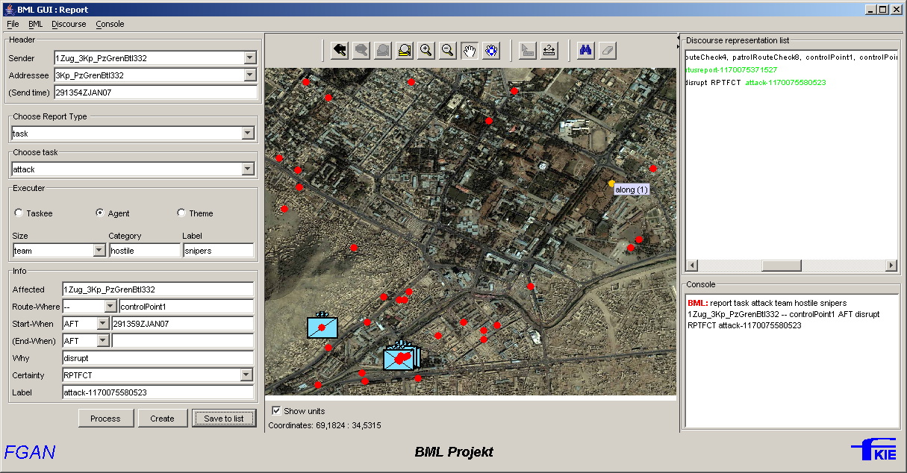
C2LG GUI Application
Used in MSG-048, SAAB Black Cactus Project, Systematic BML PoP

Slide 25
Experience with the C2LG
C2LG was used in the SAAB Black Cactus project as documented in:
    Paper 08S-SIW-017
C2LG was used in the Systematic SitaWare BML project as documented in:
    Paper 08S-SIW-039
Much experience with the NATO C-BML Working Group MSG-048 as documented in:
    Paper 08S-SIW-082
The JBML Schema is based upon the C2LG as documented in:
    Paper 07F-SIW-051

Slide 26

Towards applications of MSDL and C-BML in the Netherlands
Notes:
TNO presented paper 07S-SIW-025 after working with the prototype C2L Grammar. They
have successfully implemented and extended the grammar.

Slide 27
Conclusions
The C2LG can describe tasks in a manner consistent
with the MSDL standard.
An enumeration of available tasks along with their associated production rules will be required.
Advantages of this approach are:
  Formal Grammar
  Documented in conference papers
  Well suited to parsing and processing
  Initial Experience Base

Slide 28
Thanks for Your Attention !
Questions and Comments
are appreciated.

Slide 29
The Development of a Formal Grammar
Types of Grammar (according to Chomsky)
Type 0 “unrestricted”
Type 1 “context-sensitive” αAβ → αγβ
Type 2 “context free” A → γ
Type 3 “regular” A → aB
a ∈ Σ; A, B ∈ N; α, β, γ ∈ (N ∪ Σ)*

Slide 30
The Development of a Formal Grammar
Constituency
“Move the unit to the phase line !”
Considering the 5 Ws (What, Who, Where, When, Why),
it is clear that this expression should be split up.

Slide 31
The Development of a Formal Grammar
Constituency
“Move the unit to the phase line !”
The parts of the expression are its constituents.

Slide 32
The Development of a Formal Grammar
Constituency
“Move the unit to the phase line !”
3 constituents
Constituency has to be mirrored in the production rules:
S → V NP PP V → move NP → DET N

Slide 33
The Development of a Formal Grammar
Subcategorization (completeness and coherence)
Deploy . at Tango . until 161500ZSEP05.
Advance . from Tango . to Tulip . as soon as possible.
Attack . the 34th Bradyland MID . at Tulip.
The “verb” (type of the task)
determines which types of constituents are needed.
⇒ A lexical-driven (verb-driven) grammar is preferable.

Slide 34
The Development of a Formal Grammar
Subcategorization (lexically-driven)
The US general ordered the German general to attack.
The US general promised the German general to attack.
The “verb”
also determines the semantic roles of the constituents
and thus, it determines the meaning of the catenation.
⇒ A lexical-driven (verb-driven) grammar is needed.

Slide 35
Developing a Formal Tasking Grammar
When
act-tmprl-
assoc
Why
act-effect
act-res
What
org-act-
assoc
(Who)
Who
act-objve
act-loc
What
The 5 Ws in the JC3IEDM with
some mappings to the strucutre
Where
Notes:
16.8.2 ACTION-OBJECTIVE-ITEM
The entity ACTION-OBJECTIVE-ITEM is defined as “A battlespace object (FACILITY, FEATURE, MATERIEL, ORGANISATION, or PERSON) which is the focus of a specific ACTION.”

Slide 36
The Formal BML Tasking Grammar
task: advance
tasker: ...
taskee: name: Patrol1
type: unit
subtype: special
arm-cat: ...
size: PTL
hostility: friend
source: X
destination: Z
start: ...
modifier: speed: fast
BML order:
advance ... Patrol1 from X to Z ...
c-structure:
OB
f-structure:
advance
Taskee
Patrol1

